Slide 1



Chronic Kidney Disease Detection: A Machine Learning Model
Leveraging Machine Learning Algorithms for Accurate Diagnosis
Presented By:
Divyesh
Aswan
Aejaz
Manik

Slide 2
Chronical Kidney Disease
What is CKD?
Chronic Kidney Disease (CKD) is a long-term condition where the kidneys progressively lose their ability to function properly.
Primarily caused by diabetes, hypertension, and genetic factors.
CKD can lead to kidney failure, requiring dialysis or a transplant if not managed early.
Affects millions worldwide and is a leading cause of morbidity and mortality.

Slide 3

Algorithm-1
Logical Regression

Slide 4

Overview
Logistic regression model for detection of (CKD)
Workflow:
Data Preprocessing
Feature Selection
Model Training
Hyperparameter Tuning
Evaluation and Deployment

Slide 5
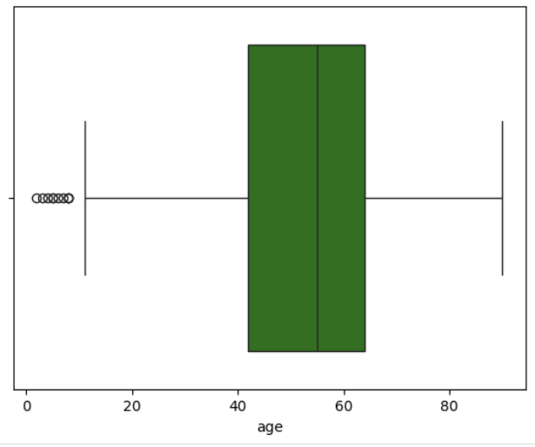
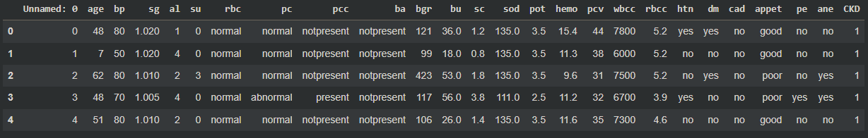
Data Preprocessing
Dataset
Data Cleaning
The dataset used for this model retrieved from [ UC Irvine Machine Learning Repository ]
Removed redundant column and handled missing values.
Encoded categorical features using LabelEncoder.
Handled outliers in numerical features using the IQR method.

Slide 6

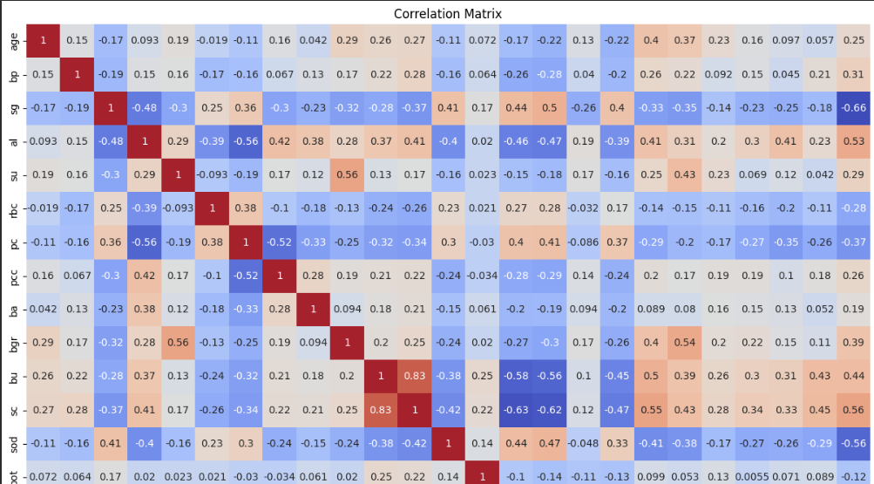

Feature Selection and Model Building
Feature Selection
Based on correlation values ≥ 0.29 with CKD.
Model: Logistic Regression
Baseline model trained with limited iterations (max_iter=10).
Tuned model using GridSearchCV for optimal C value.

Slide 7
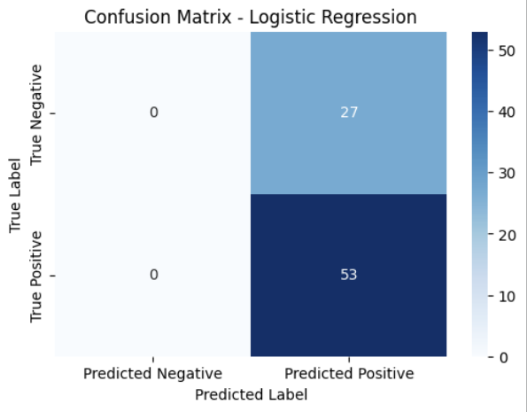
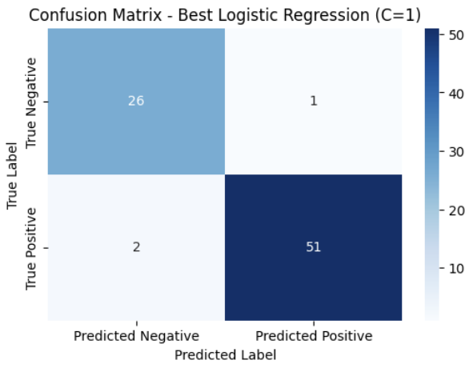
Model Performance
VS
Baseline Model Accuracy
Tuned Model Accuracy

Slide 8
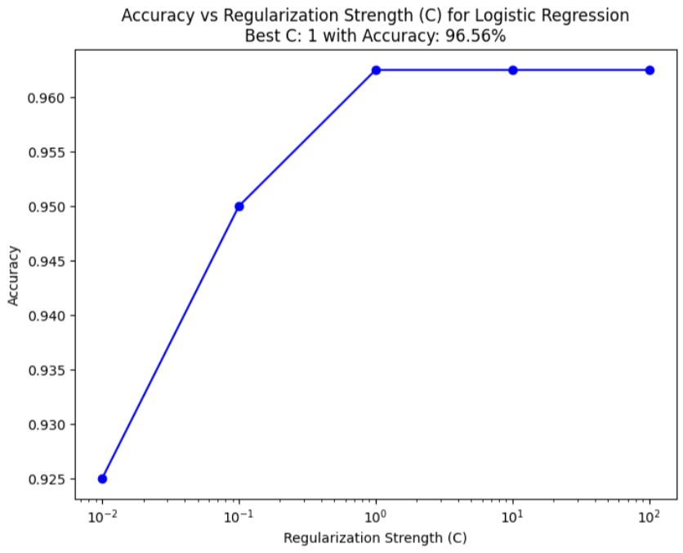
Accuracy vs. Regularization Strength
Regularization Strength (C): Low C values increase regularization, reducing overfitting but lowering accuracy. High C values reduce regularization, improving fit but risking overfitting.
Optimal C: The best C value found is {best_C}, achieving the highest cross-validation accuracy.
Trend Observation: Accuracy initially improves with increasing C, peaks at the optimal value, and then stabilizes or declines due to overfitting.
Deployment Insight: Using the optimal C ensures the model balances accuracy and generalizability.

Slide 9
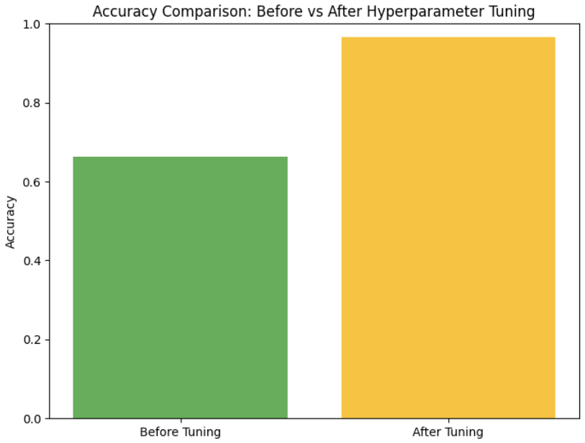
Key Outcomes and Conclusion
Methodology
Achieved improved accuracy after hyperparameter tuning.
Saved the model for deployment (best_logistic_model.pkl).
The tuned model offers robust predictions for CKD detection.
Future Scope
Integrate additional features and test on a larger dataset.

Slide 10
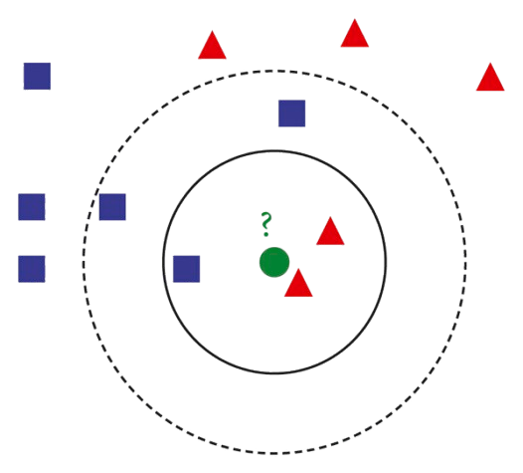
Algorithm-2
K-Nearest Neighbors (KNN)

Slide 11
K-Nearest Neighbors (KNN) Analysis CKD Dataset
Introduction to KNN
Dataset Overview
K-Nearest Neighbors (KNN) is a supervised machine learning algorithm.
It classifies data points based on the majority class of their nearest neighbors.
Used for both classification and regression tasks.
Here, KNN is applied to analyze the CKD dataset.
Dataset: CKD (Chronic Kidney Disease)
Contains attributes related to kidney disease diagnosis.
Data used to train the KNN algorithm to predict outcomes.

Slide 12
K-Nearest Neighbors (KNN): Methodology and Implementation
Methodology
Implementation
KNN uses the distance between data points to find the k-nearest neighbors to a new data point, and predicts its class based on the majority class of its neighbors.
KNN is implemented by calculating the distance between data points and identifying the nearest neighbors based on a chosen metric, such as Euclidean distance.

Slide 13
WORK FLOW
1. Load and preprocesses the dataset
2. Split the data into training and test sets
3. Train the KNN Model
4. Evaluate the model with accuracy and confusion matrix
5. Plot the accuracy for varying k values

Slide 14
KNN Model Implementation
1. Data Preprocessing:
- Handled missing values.
- Scaled the features for uniformity.
-Normalizes the data using Standard Scaler.
2. Model Training:
- Split data into 70% training and 30% testing sets.
- Trained the model using different 'k' values.
3. Model Evaluation:
- Computes the accuracy score.
- Displays a confusion matrix.

Slide 15
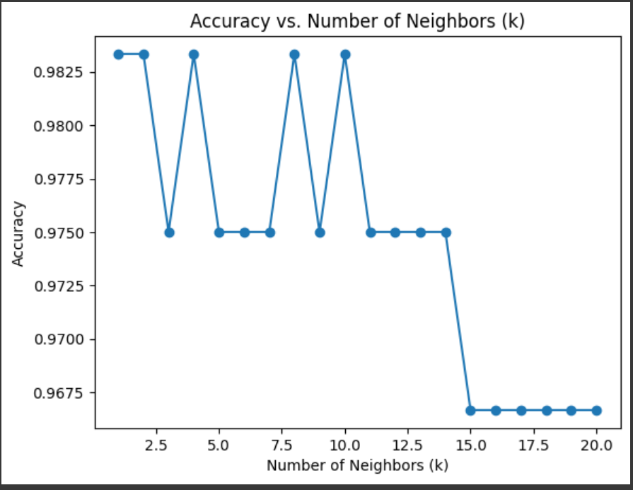
Accuracy vs. Number of Neighbors (k)
The accuracy of the model was evaluated for different values of k (number of neighbors)
Observations:
-The accuracy fluctuates for small values of k, peaking at k=1,5,9,11 .
-Beyond k=15, the accuracy drops significantly.
-Optimal k value appears to be 1 or 9 for highest accuracy .

Slide 16
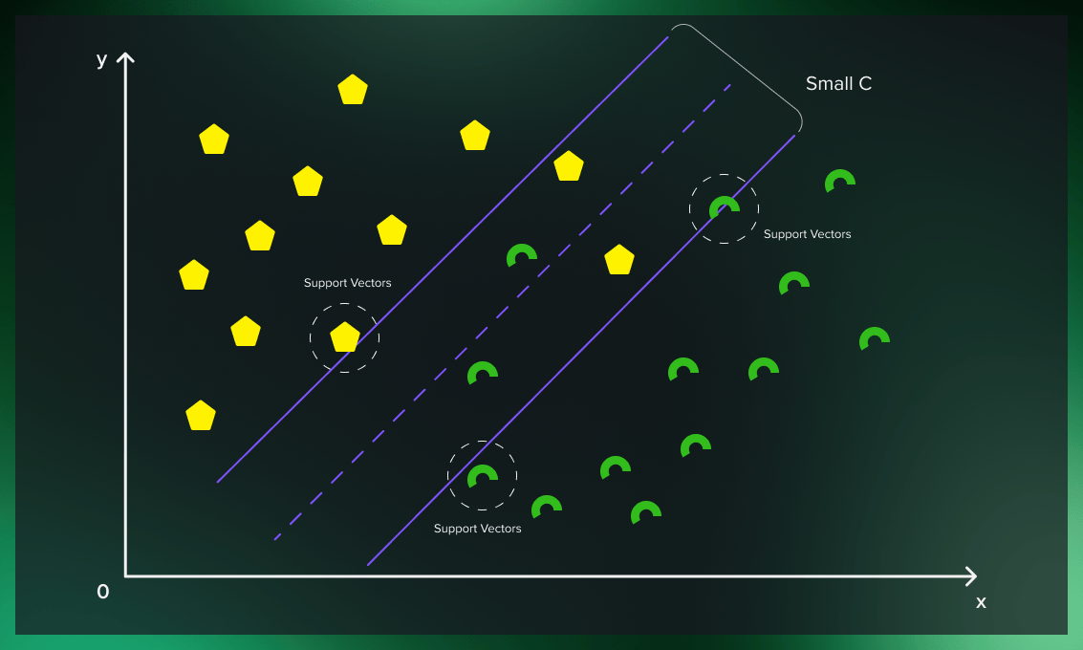
Algorithm-3
Support Vector Machine
(SVM)

Slide 17
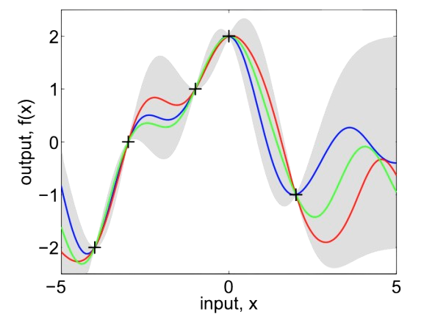
Algorithm-4
Gaussian Process Regression

Slide 18
What is Gaussian Process Regression Algorithm?
Gaussian Process Regression (GPR) is a powerful, non-parametric machine learning algorithm used for regression tasks.
It models a distribution over possible functions that fit the data, rather than relying on a specific functional form.
Instead of using any predefined function the GPR models the data by Gaussian Process by collecting random variables at finite number of points.
Time series prediction
Geospatial data modelling
Machine learning in robotics
optimization problems
Applications

Slide 19
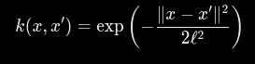
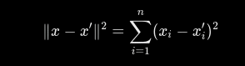
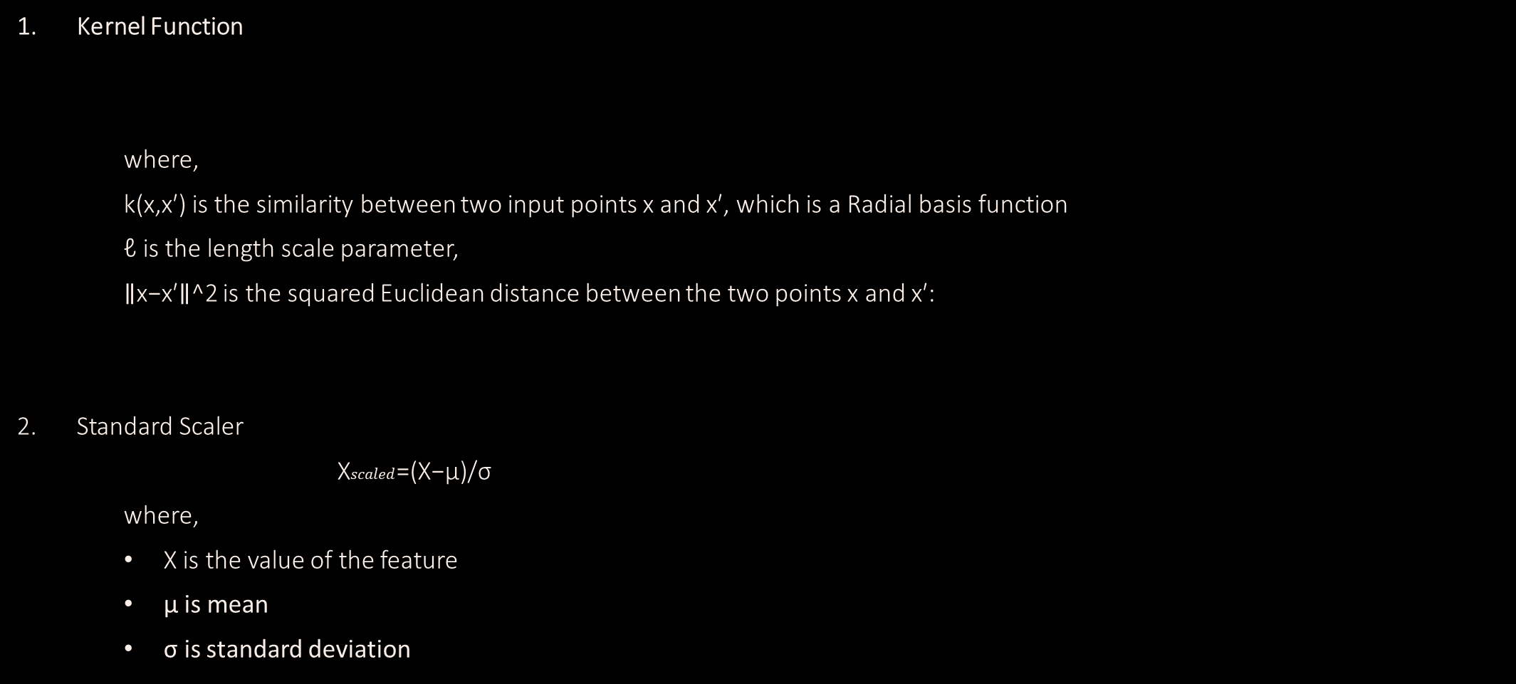
How it Works?
Kernel Function
where,
k(x,x′) is the similarity between two input points x and x′, which is a Radial basis function
ℓ is the length scale parameter,
∥x−x′∥^2 is the squared Euclidean distance between the two points x and x′:
Standard Scaler
X$scaled$​=(X−μ)/σ​
where,
X is the value of the feature
μ is mean
σ is standard deviation

Slide 20
Comparison of Model Performance Metrics
Accuracy
Precision
The proportion of correctly classified instances.
(TP+TN)
(TP+TN+FP+FN)
The proportion of true positives among predicted positives.
TP
(TP+FP)
Accuracy =
Precision =
Recall (Sensitivity)
F1-score
The proportion of true positives among actual positives.
TP
(FN+TP)
The harmonic mean of precision and recall.
2*Precision*Recall
Precision + Recall
F1-score =
Recall =

Slide 21
Comparison of Model Performance Metrics
Accuracy
Precision
The proportion of correctly classified instances.
(TP+TN)
(TP+TN+FP+FN)
The proportion of true positives among predicted positives.
TP
(TP+FP)
Accuracy =
Precision =
Recall (Sensitivity)
F1-score
The proportion of true positives among actual positives.
TP
(FN+TP)
The harmonic mean of precision and recall.
2*Precision*Recall
Precision + Recall
F1-score =
Recall =

Slide 22
Comparison of Model Performance Metrics
Accuracy
Precision
The proportion of correctly classified instances.
(TP+TN)
(TP+TN+FP+FN)
The proportion of true positives among predicted positives.
TP
(TP+FP)
Accuracy =
Precision =
Recall (Sensitivity)
F1-score
The proportion of true positives among actual positives.
TP
(FN+TP)
The harmonic mean of precision and recall.
2*Precision*Recall
Precision + Recall
F1-score =
Recall =

Slide 23
Comparison of Model Performance Metrics
Accuracy
Precision
The proportion of correctly classified instances.
(TP+TN)
(TP+TN+FP+FN)
The proportion of true positives among predicted positives.
TP
(TP+FP)
Accuracy =
Precision =
Recall (Sensitivity)
F1-score
The proportion of true positives among actual positives.
TP
(FN+TP)
The harmonic mean of precision and recall.
2*Precision*Recall
Precision + Recall
F1-score =
Recall =

Slide 24
Comparison of Model Performance Metrics
Accuracy
Precision
The proportion of correctly classified instances.
(TP+TN)
(TP+TN+FP+FN)
The proportion of true positives among predicted positives.
TP
(TP+FP)
Accuracy =
Precision =
Recall (Sensitivity)
F1-score
The proportion of true positives among actual positives.
TP
(FN+TP)
The harmonic mean of precision and recall.
2*Precision*Recall
Precision + Recall
F1-score =
Recall =

